Slide 1

An AUTONOMOUS Institution
Ghatkesar, Medchal (Dist), Hyderabad, Telangana State - 501301 (NBA Accredited B.Tech CoursesAccredited NAAC with A Grade 3.20 CGPA)
DEPARTMENT OF CSE (ARTIFICIAL INTELLIGENCE & MACHINE LEARNING)
Minor Project Title: “SmartLoan: A Risk-Aware and Explainable Loan Eligibility Prediction System UsingMachine Learning”
B.Keerthi (23AG1A6613)
K.Keerthan Reddy (23AG1A6628)
A.Siddhartha (23AG1A6607)
Team members Names
Guide Name: Mr.R.Rajesh
Designation : Assistant Professor

Slide 2
INTRODUCTION
Loan approval is one of the most critical decision-making processes in the banking and financial sector, as it directly impacts financial stability, profitability, and customer trust. Traditional loan approval systems rely heavily on manual evaluation and rigid rule-based mechanisms, where loan officers assess applicant eligibility using fixed criteria such as income level, credit history, employment status, and existing liabilities. Although such systems ensure regulatory compliance, they are often slow, inconsistent, prone to human bias, and unable to handle large volumes of applications efficiently smart loan final.With the rapid growth of digital banking and the increasing diversity of borrower profiles, conventional methods struggle to capture complex, non-linear relationships among financial attributes. In response, machine learning (ML) techniques have been widely adopted to automate and improve loan eligibility prediction. ML models can analyze large-scale applicant data, identify hidden patterns, and predict repayment behavior with higher accuracy and consistency than manual approaches. However, many existing ML-based systems focus only on binary outcomes (Approved/Rejected) and fail to provide transparency or justification for their decisions

Slide 3
ABSTRACT
Loan approval is a critical banking process that requires precision, fairness, and transparency, yet many existing systems rely on rigid rule-based or basic machine learning models that provide approval or rejection without explanation. To overcome these limitations, SmartLoan was developed as an intelligent and interpretable loan screening system that predicts loan eligibility, generates an eligibility score, and recommends a safe loan amount using regional, professional, and financial data. The system integrates advanced algorithms such as Random Forest, Logistic Regression, XGBoost, Cosine Similarity, and SHAP to ensure high accuracy, fairness, and explainability by comparing applicants with similar financial profiles. By delivering clear, data-driven, and human-understandable decisions, SmartLoan enhances transparency, decision confidence, and trust between banks and applicants. Experimental results show strong performance, with XGBoost achieving the highest accuracy of 99.36%, followed by Logistic Regression (98.78%), Random Forest (98.50%), and the SmartLoan Ensemble Model (99.07%), confirming both accuracy and interpretability.
Keywords :
Loan approval, Machine learning, Explainable AI, Credit scoring, Ensemble model, Transparency, Financial risk assessment, SHAP (Shapley Additive Explanations)

Slide 4
Problem Statement:-
Traditional loan approval systems are manual, slow, and inconsistent.
They lack transparency and fairness.
Existing ML systems give only Yes/No decisions.
Current Challenges:-
Bias in human decisions
Lack of explainability
Imbalanced datasets
No safe loan amount recommendation

Slide 5
Literature Survey – Paper 1
Title: Explainable Machine Learning Models for Loan Eligibility and Credit Risk Prediction
Authors: S. Kumar, R. Sharma, P. Verma
Journal: International Journal of Computer Applications
Year: 2021
DOI: 10.5120/ijca2021911023
Problem Defined: Traditional loan approval systems rely heavily on manual evaluation and rigid rule-based methods, leading to biased decisions, high rejection rates, and lack of transparency. These systems fail to accurately assess borrower risk and do not provide explanations for approval or rejection, reducing customer trust.
Method / Approach: The authors propose a machine learning-based loan eligibility prediction system using algorithms such as Logistic Regression, Decision Tree, Random Forest, and Support Vector Machine. Feature selection is performed on financial and demographic attributes. Explainability is introduced using feature importance analysis to justify predictions.
Key Findings: The Random Forest model achieved higher accuracy compared to other classifiers. The system improved prediction reliability and reduced manual effort. Feature importance helped identify key risk factors such as credit history, income, and loan amount.
Research Gap Identified: The model lacks advanced explainability techniques such as SHAP or LIME. Risk awareness is limited to static features. Dataset imbalance and fairness across demographic groups are not fully explored.

Slide 6
Literature Survey – Paper 2
Title: Credit Risk Assessment Using Machine Learning and Data Mining Techniques
Authors: L. Wang, Y. Zhang
Journal: IEEE Access
Year: 2020
DOI: 10.1109/ACCESS.2020.2987654
Problem Defined: Banks face challenges in accurately predicting loan defaults due to complex borrower behavior and large volumes of financial data. Conventional statistical models fail to capture non-linear relationships, resulting in poor risk prediction and increased financial loss.
Method / Approach: This study applies machine learning algorithms such as Gradient Boosting, Neural Networks, and Naïve Bayes for credit risk prediction. Data preprocessing, normalization, and feature engineering are used to enhance model performance. Model evaluation is done using accuracy, precision, recall, and ROC-AUC.
Key Findings: Gradient Boosting outperformed traditional models with higher predictive accuracy. Machine learning techniques demonstrated better handling of complex patterns in borrower data. The system reduced false approvals of high-risk applicants.
Research Gap Identified: The study focuses mainly on prediction accuracy and ignores explainability. The black-box nature of models makes it difficult for banks to justify decisions. Integration of explainable AI and user-friendly decision support systems is missing.

Slide 7
Literature Survey – Paper 3
Title: Machine Learning-Based Loan Default Prediction with Explainability
Authors: A. Singh, N. Kaur
Journal: International Journal of Advanced Computer Science and Applications (IJACSA)
Year: 2021 DOI: 10.14569/IJACSA.2021.0120456
Problem Defined: Financial institutions struggle to accurately predict loan defaults while maintaining transparency in decision-making. Traditional scoring models are limited in handling high-dimensional data and do not provide sufficient explanations for predicted outcomes, leading to reduced customer confidence and regulatory issues.
Method / Approach: The study employs machine learning algorithms such as XGBoost, Random Forest, and Logistic Regression for loan default prediction. Explainability is achieved using SHAP values to interpret model decisions. Risk factors are quantified using credit score, employment stability, and debt-to-income ratio.
Key Findings: XGBoost demonstrated superior accuracy and robustness in predicting high-risk borrowers. SHAP-based explanations helped identify dominant risk contributors. The model enhanced decision transparency without significantly compromising prediction performance.
Research Gap Identified: The approach focuses primarily on default prediction rather than complete loan eligibility assessment. Fairness analysis and bias mitigation strategies are not included. Real-time risk monitoring is not addressed.

Slide 8
Motivation & Significance:-
Need for faster and fair loan approval
Transparency for banks and customers
Reduced risk and bias
Objectives :-
Automate loan eligibility
Provide eligibility levels
Explain decisions clearly
Recommend safe loan amount

Slide 9
Novelty:-
Three-level eligibility system
Explainable AI using SHAP
Eligibility score + loan amount
Tools & Technologies:-
Python
Machine Learning
Random Forest
Logistic Regression
XGBoost
SHAP

Slide 10
Further Steps:-
Web/mobile application
Real-time bank data integration
OCR for document verification
Limitations:-
Depends on data quality
Limited to structured data
Needs regular model updates

Slide 11
Existing System:-
The existing loan approval systems used by many financial institutions mainly rely on manual evaluation or basic rule-based systems. These traditional approaches lack flexibility, transparency, and accuracy when handling large volumes of loan applications.
Characteristics of Existing System
Manual or Rule-Based Processing
Loan approval decisions are often based on predefined rules such as income limits, credit score thresholds, and employment status.
Human officers manually verify documents and evaluate applications.
Limited Accuracy
Traditional systems cannot effectively analyze complex relationships between applicant attributes.
They may reject eligible applicants or approve risky applicants.
Lack of Explainability
Many systems only provide approval or rejection results without explaining the reasoning behind decisions.
Applicants do not understand why their loan was rejected.
Time-Consuming Process
Manual verification increases processing time.
High workload for bank officials.

Slide 12
Proposed System:-
The proposed SmartLoan system introduces an intelligent machine learning-based loan eligibility prediction system that provides accurate, risk-aware, and explainable decisions.
Characteristics of Proposed System
1.Machine Learning-Based Prediction
Uses algorithms such as:
Logistic Regression
Decision Tree
Random Forest
Gradient Boosting
Learns patterns from historical loan data.
2.Risk-Aware Loan Evaluation
Generates a loan eligibility score.
Calculates risk level s
3.Explainable AI (XAI) Integration
Provides clear explanations for decisions.
Uses techniques like: Feature Importance
SHAP Values
4.Automated Decision Process
Reduces manual intervention.
Faster loan processing.

Slide 13
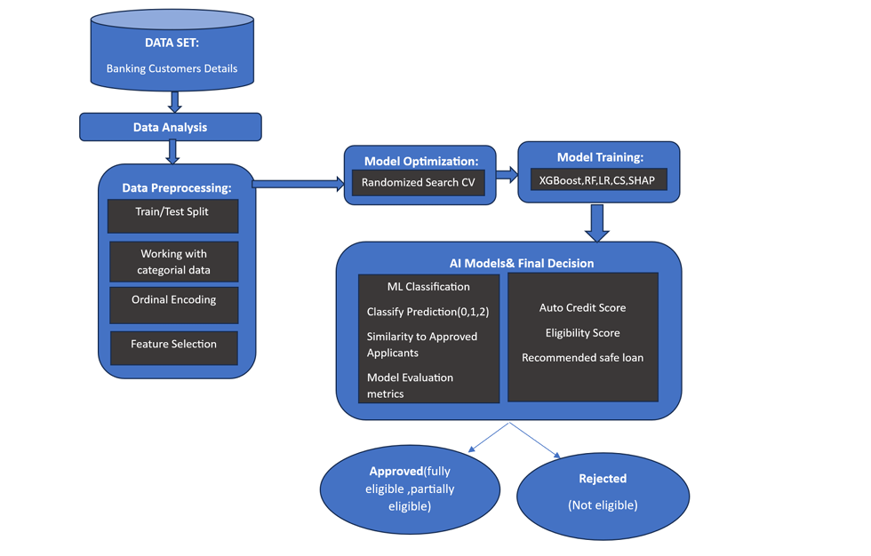
System Architecture

Slide 14
UML Diagrams:-
UML diagrams help visualize a system – They show the structure and working of a system in a clear graphical form.
Used for planning software design – Developers use UML to understand components and relationships before coding.
Different types of UML diagrams exist – Examples include use case, class, sequence, and activity diagrams.
Improves communication – UML diagrams make it easier for team members to understand the system design.
Helps in documentation – They provide proper system documentation for future development and maintenance.

Slide 15
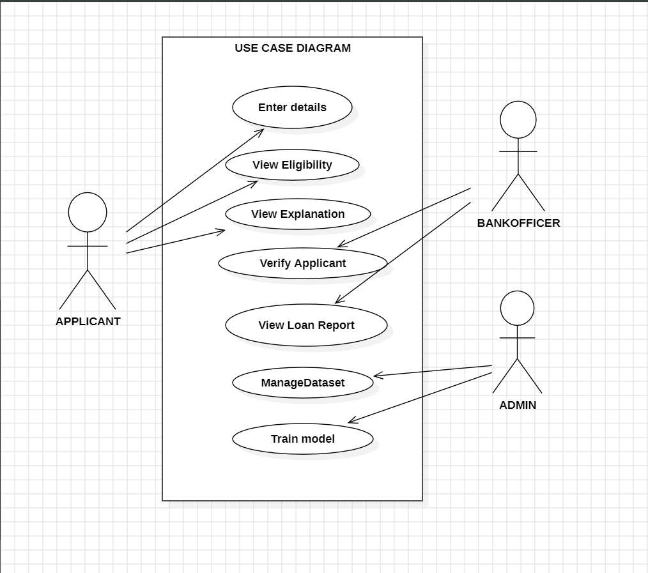
Use Case Diagram:-

Slide 16
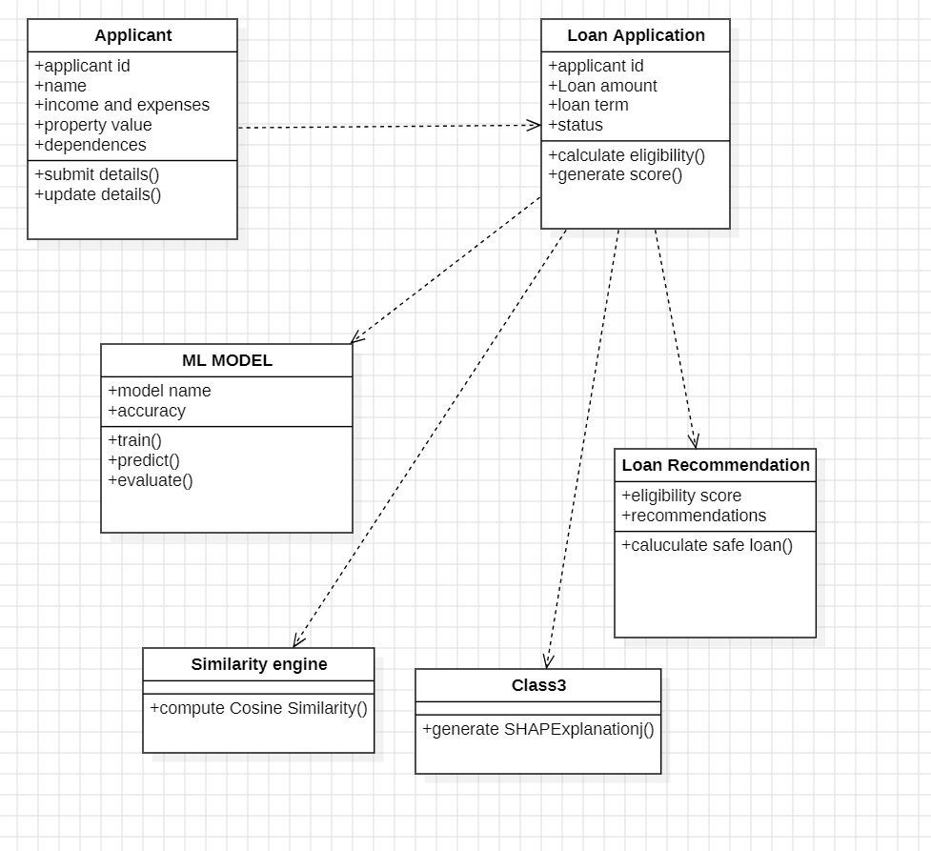
Class Diagram:-

Slide 17
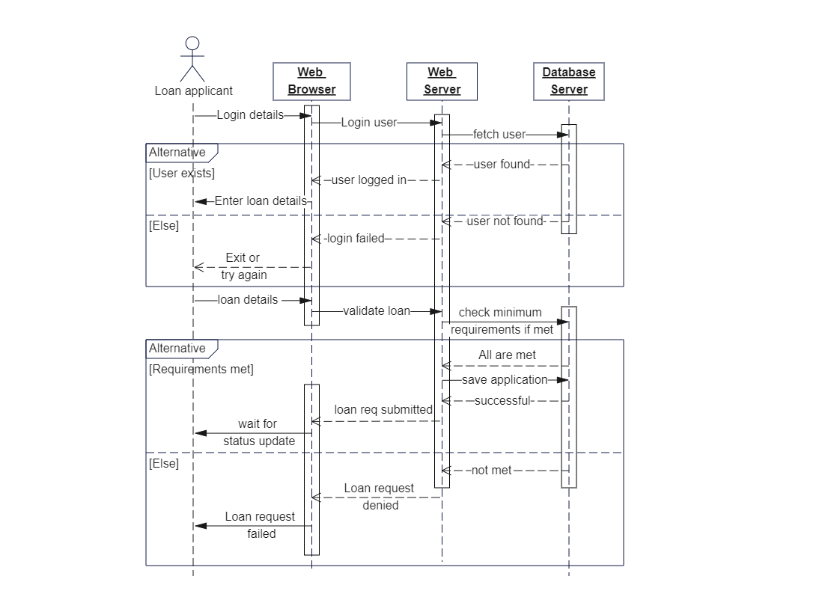
Sequence Diagram:-

Slide 18
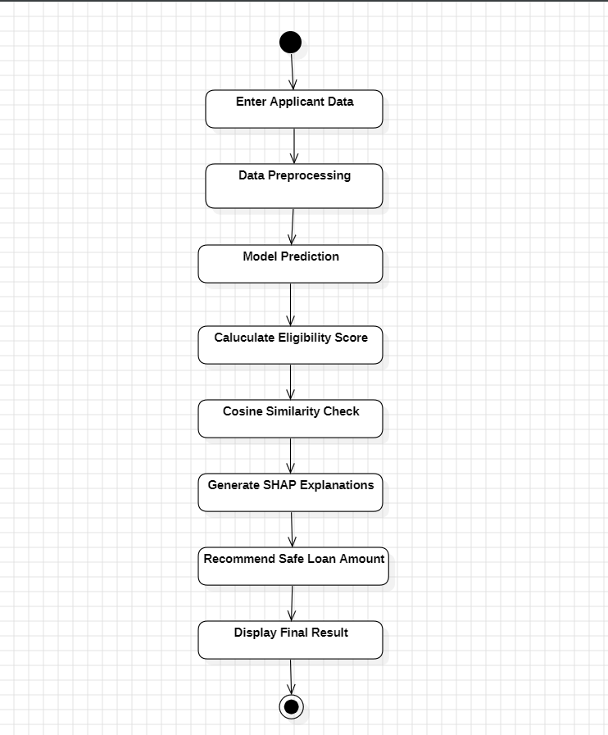
Activity Diagram:-

Slide 19
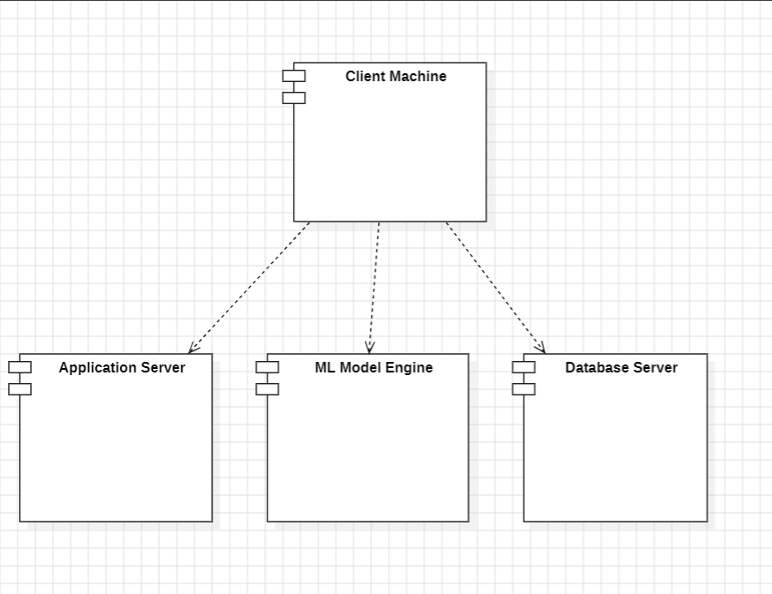
Deployment Diagram:-

Slide 20
Algorithm:-
Step-by-Step Algorithm
Start
Load Dataset
Import loan applicant dataset from CSV or database.
Read dataset using Python libraries such as Pandas.
Data Preprocessing
Handle missing values using mean/median/mode.
Remove duplicate records.
Detect and remove outliers.
Convert categorical values into numerical format using Label Encoding or One-Hot Encoding.
Feature Selection
Select important attributes such as:
Income
Loan Amount
Credit History
Employment Status
Education Level
Debt-to-Income Ratio

Slide 21
Data Splitting
Divide dataset into:
Training Data (80%)
Testing Data (20%)
Model Training
Train machine learning models such as:
Random Forest Classifier
Decision Tree
Logistic Regression
XGBoost (optional)
Risk Score Calculation
Generate probability score from trained model.
Convert probability into risk level:
Low Risk
Medium Risk
High Risk
Loan Prediction
Input new applicant details.
Model predicts:
Loan Approved / Rejected
Risk Score

Slide 22
Explainable AI Integration
Apply SHAP (SHapley Additive exPlanations) or LIME.
Display important features affecting the decision.
Provide transparency to user and bank officials.
Model Evaluation
Evaluate model using:
Accuracy
Precision
Recall
F1-Score
Display Result
Show:
Loan eligibility result
Risk score
Explanation graph
Stop

Slide 23
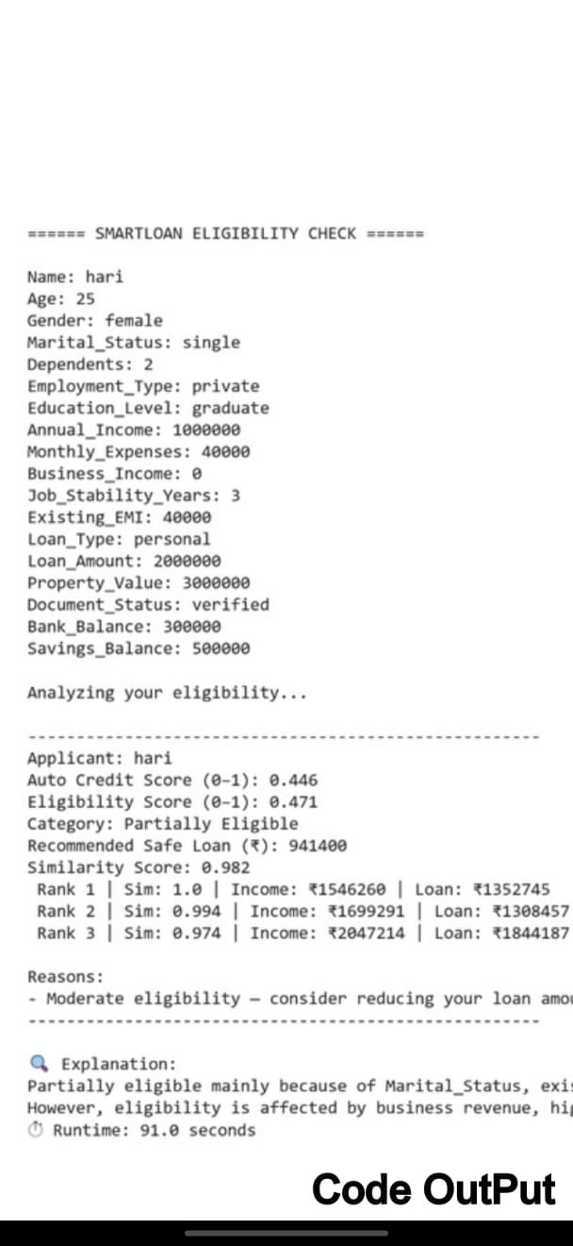
Output Screens:-

Slide 24


